Slide 1

Insurance Management system
PES UNIVERSITY (Established under Karnataka Act No. 16 of 2013) 100 Ft. Road, BSK III Stage, Bengaluru – 560085
Course code : UE17CS342
Submitted By:
Ismail Mulla PES1201802409
Adarsh PES1201701399
Pramoth PES1201701807
Yadhunandan PES1201701404

Slide 2
Contents
Introduction
Objective of the System
Existing system
Working of the system
Software Requirements
Hardware Requirements
Tools and Techniques
Screen shot
conclusion

Slide 3
Introduction
The proposed system is for making easier.
It helps to manage policy holder details, agent details, policy details, claimant details and payment details.
So this will be developed for managing the insurance management system.
The system contains ◻home. ◻Login. ◻About us. ◻Sign in. ◻Contact us.

Slide 4
Objective of the system
To computerize the Insurance system.
To reduce Data Redundancy.
To reduce the Cumbersome job of Maintaining several documents.
To eliminate the delays in Report Generation.
To facilitate faster Searching of information.
Thus reducing time, energy and cost.
To Give Assurance To the Policy Holders About Maintaining Data Privacy and Security.

Slide 5
Existing System
Vehicle Insurance:
Customer Visits an Agent and asks him to insure his vehicle.
Agent takes the customer details and the vehicle details (i.e. RC Book, and vehicle registration papers)
Agent forwards the Details to the Company.
Company gives the Quotation to the agent for different coverage's.
Agent gives the quotation amount to the customer.
Customer as per his convenience asks to issue the policy under the coverage of his choice.

Slide 6
Cont:
Agent takes the cheque or cash for the policy from the customer.
Agent gives the cheque to the company and request them to issue the policy for the vehicle.
Company arranges a check for the vehicle to be insured.
If the vehicle is in Condition and passes the test set by the insurance company the vehicle is then insured by the company.
The policy copy is then issued to the customer and sent to the mail address.
The agent receives the commission as set by the company after the issuance of the policy

Slide 7
Working of the system
The system contains ◻Home. ◻About us. ◻Contact us. ◻Log in.
There are Three main users in this system, ◻Manager, ◻Agent and ◻Client.
The Manager can add, search and delete the Agent and the policy.
The Agent can add, search and delete the user but he can’t add the policy
The User can request for the policy and he can search the policy

Slide 8
Software Requirements
WINDOWS OS
Mysql 8
Ecliplse Neon
Apache tomacat 8
Java 8
Language Tools: HTML5, JSP, Mysql

Slide 9
Hardware Requirements
Processor: Pentium 3 and above
RAM: 1GB with 256MHz
Hard disk: 2GB
Keyboard: Standard 101 key keyboard
Mouse: PS/2

Slide 10
Tools and technique’s:
HTML5
CSS
BOOTSTRAP
SQL
JSP
Eclipse

Slide 11
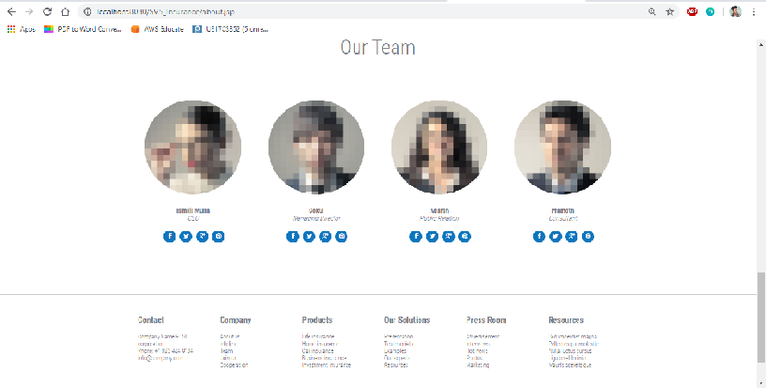
Screen shots
Our Team:

Slide 12
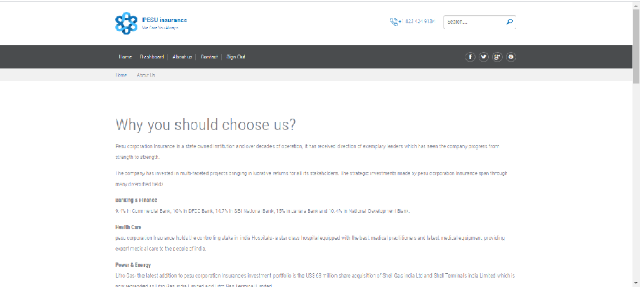
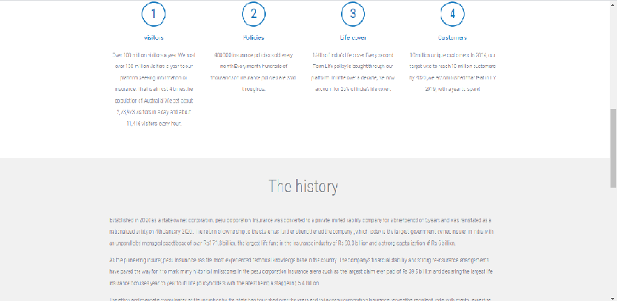
About us:

Slide 13
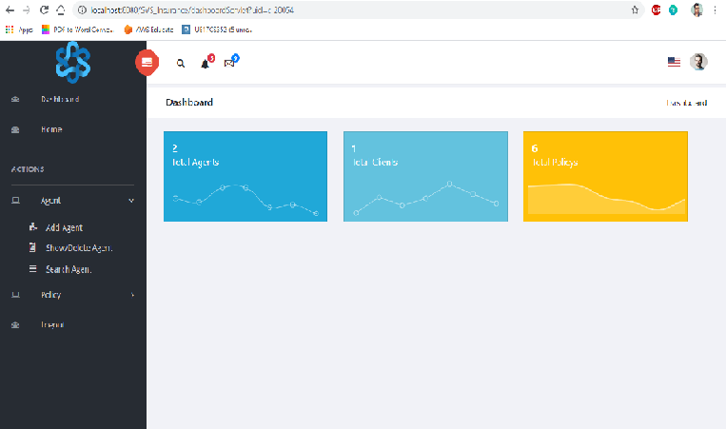
Manager Interface

Slide 14
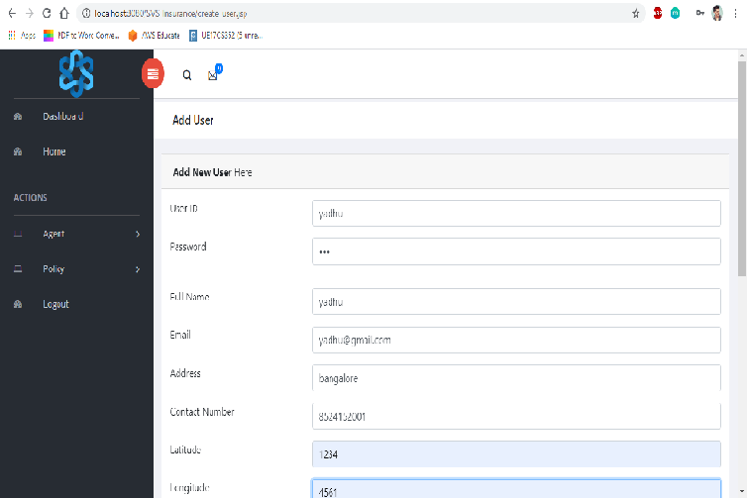
Add Agent:

Slide 15
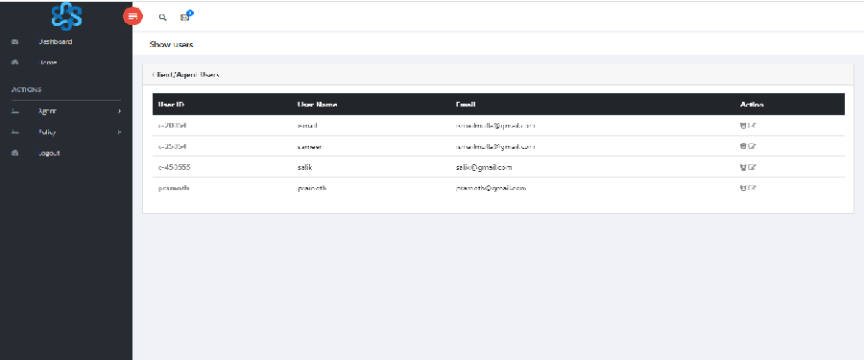
Show or delete users:

Slide 16
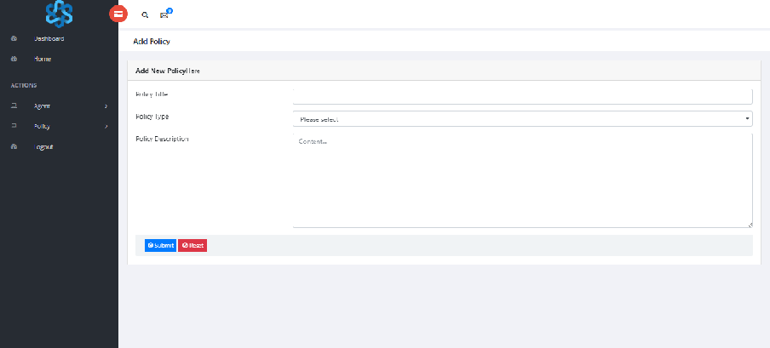
Add policy:

Slide 17
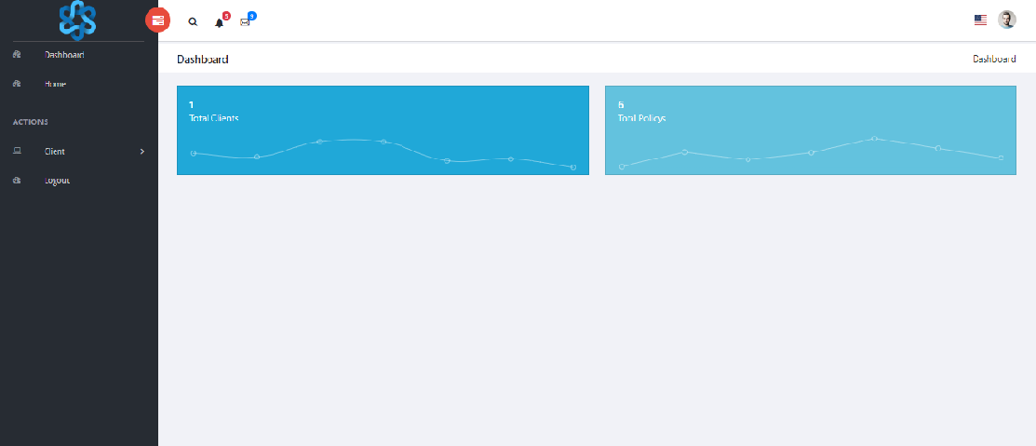
Agent interface:

Slide 18
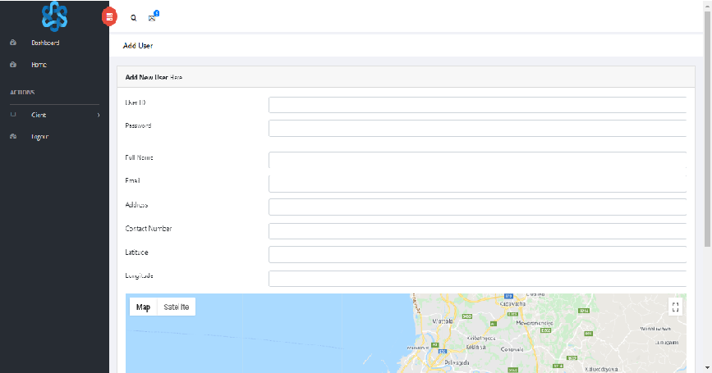
Add user:

Slide 19
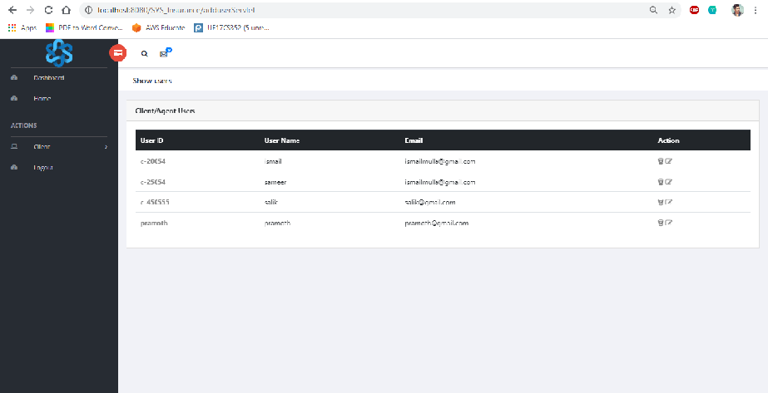
Show or delete users:

Slide 20
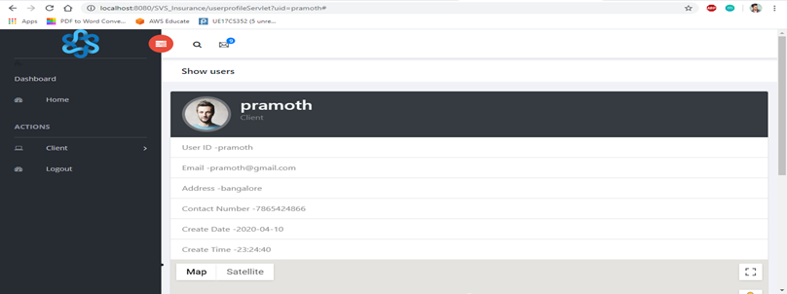
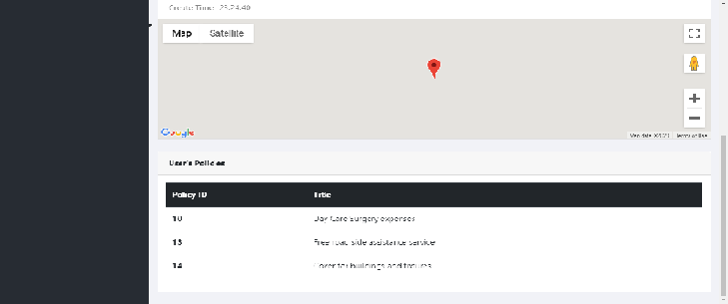
Client interface:

Slide 21
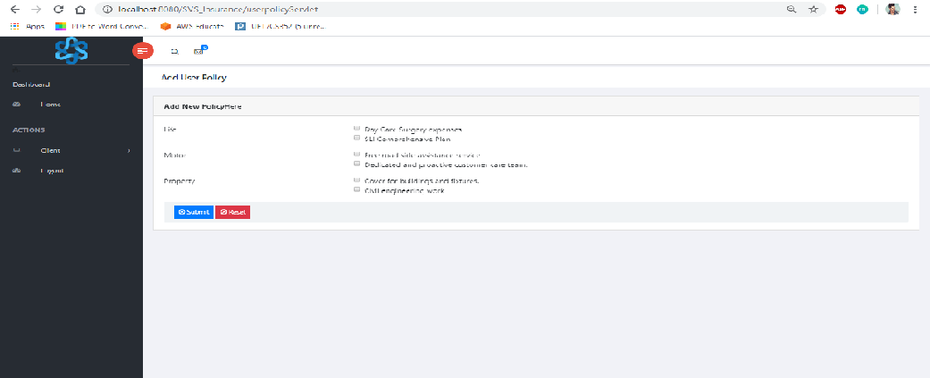
Request for new policy:

Slide 22
CONCLUSION
Insurance is a large investment and you will most likely purchase multiple policies throughout your lifetime.
It is essential that you know what each type of insurance covers and how it works so you can make the best decision about what to buy.
Do not base your decision on just what is cheapest, but look at what it provides.
People often say they cannot afford insurance, but the reality is that they cannot afford not to have it.
It can save them from thousands or more dollars in unplanned expenses when unexpected situations arise.
You do not want to waste your money on policies that do not meet your needs, but the right insurance policy can protect you and your family from unforeseen disasters.

Slide 23
BIBILOGRAPHY
https://www.w3schools.com/
https://www.codecademy.com/learn/learnhtml
https://www.udemy.com/topic/css/

Slide 24
Thank You

